Slide 1
Pembroke Community School Needs
Assessment
Kelly Miller
Department of Counseling, University of North Carolina at Pembroke
CNS 5550 Seminar in Professional School Counseling
Dr. Dana Unger, PhD
July 7, 2024
HOME

Slide 2
Pembroke Community School Status: Low Performing
Student Total
Students with disabilities
English Language Learners
Race/ethnicity
Socioeconomic status
Elementary 590
Middle 332
High School 755
Total 1,677
14%
8%
Chronic Absenteeism
American Indian 1,191 (50%)
Black 201 (30%)
Hispanic 164 (10%)
Two or more races 63 (3%)
White 58 (7%)
18%
Economically disadvantaged 64%
Gender
Male 51.3%
Female 48.7%
HOME

Slide 3
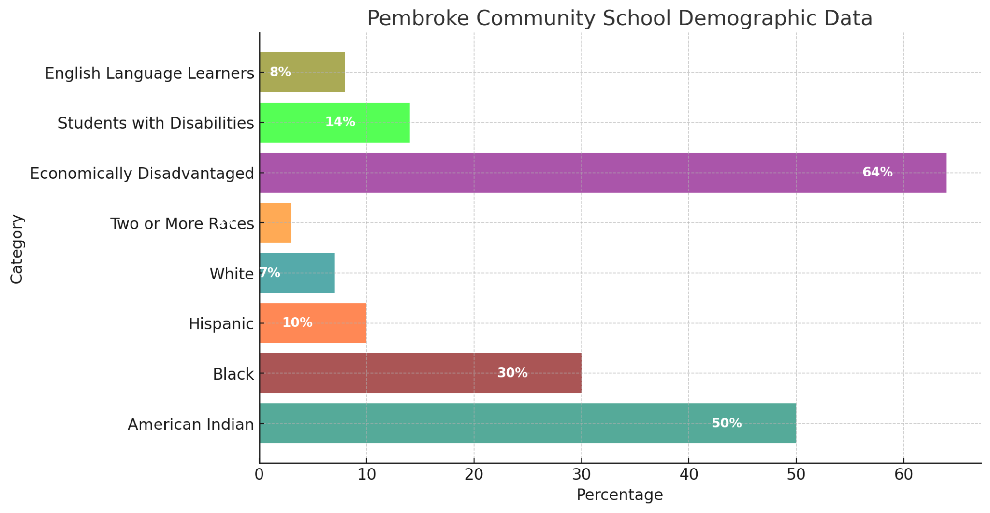
Graphic for PCS Demographic Data
HOME

Slide 4
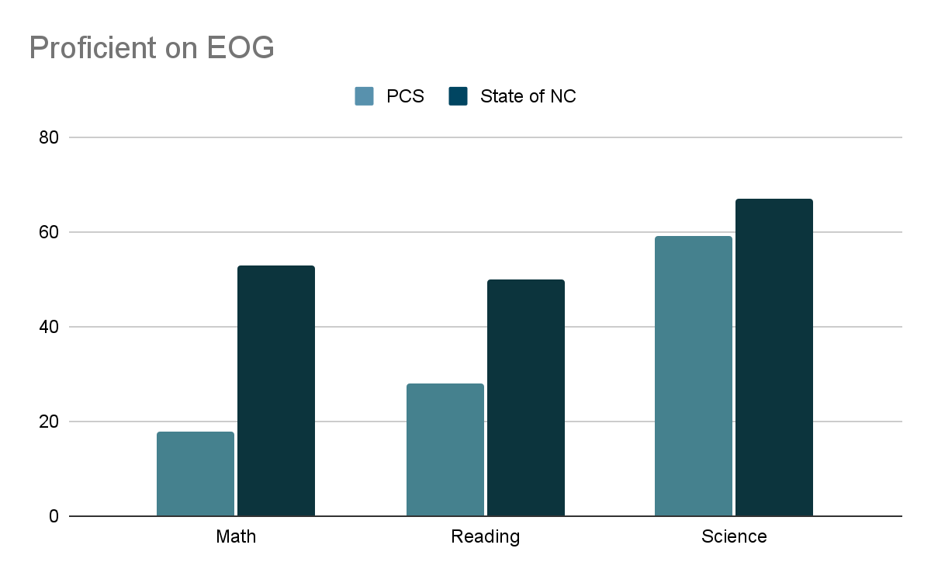
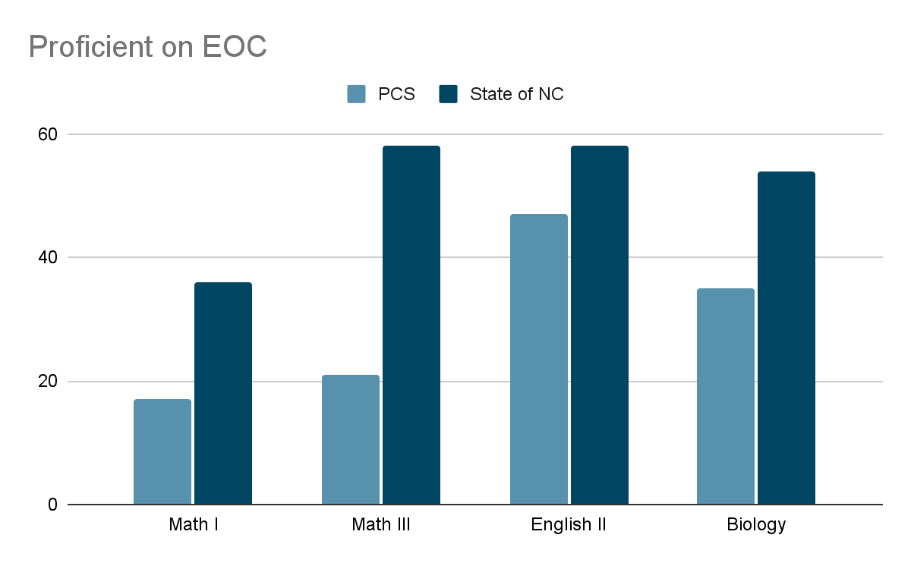
Achievement Data: EOG & EOC Scores
Pembroke Community Schools falls below the NC state average on every subject tested with the largest discrepancy in Math.
HOME

Slide 5
Achievement Data: EOG & EOC Scores
Subject | Not Proficient (%) | Level 3 (%) | Level 4 (%) | Level 5 (%)
Math | 82 | 13 | 5 | 0
Reading | 72 | 17 | 10 | 0
Science | 59 | 11 | 28 | 2
Biology | 65 | 7 | 22 | 6
English II | 53 | 27 | 18 | 2
NC Math 1 | 83 | 14 | 0 | 0
NC Math 3 | 79 | 15 | 5 | 1
HOME

Slide 6
Achievement Data: Disaggregated Math Data
02
01
03
Math I
Math EOG
Math III
Students with disabilities 95%
English Language Learners 95%
Black 90%
Economically disadvantaged 88%
English Language Learners 95%
Students with disabilities 94%
Black 86%
Economically disadvantaged 85%
Students with disabilities 95%
English Language Learners 95%
American Indian 93%
Black 90%
HOME

Slide 7
Data Analysis
Overall, 83% of students are not proficient in NC Math 1, and 79% are not proficient in NC Math 3. Particularly concerning is the performance of subgroups, such as males, with 91% not proficient in Math 1, and economically disadvantaged students, with 88% not proficient in Math 1 and 87% not proficient in Math 3. Black students also have high non-proficiency rates, with 90% in both Math 1 and Math 3. Students with disabilities show extremely high non-proficiency rates, with over 95% in Math 1 and 95% in Math 3.
Develop individualized learning plans for students who are struggling, especially those in the high-risk subgroups. Provide professional development for teachers focused on effective math instruction strategies, differentiation, and culturally responsive teaching. Emotional and psychological support can be provided through school counselors to help students build confidence and reduce math anxiety.
HOME

Slide 8
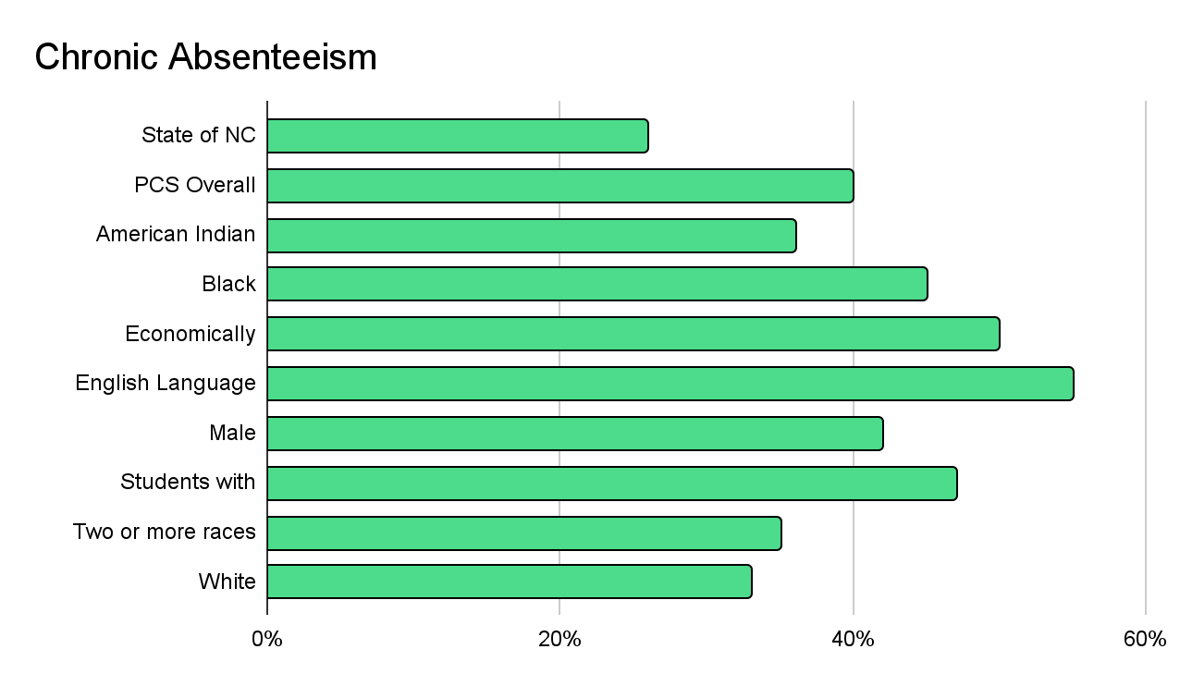
Achievement Related Data: Chronic Absenteeism
HOME

Slide 9
Data Analysis
Chronic absenteeism can significantly hinder a student's academic performance, social development, and overall well-being. It can lead to lower grades, increased dropout rates, and diminished future opportunities. Addressing chronic absenteeism is crucial to ensure all students have the opportunity to succeed.
Early identification, personalized support, family engagement, and school-wide initiatives create a comprehensive approach that fosters a culture of regular attendance and academic success.
HOME

Slide 10
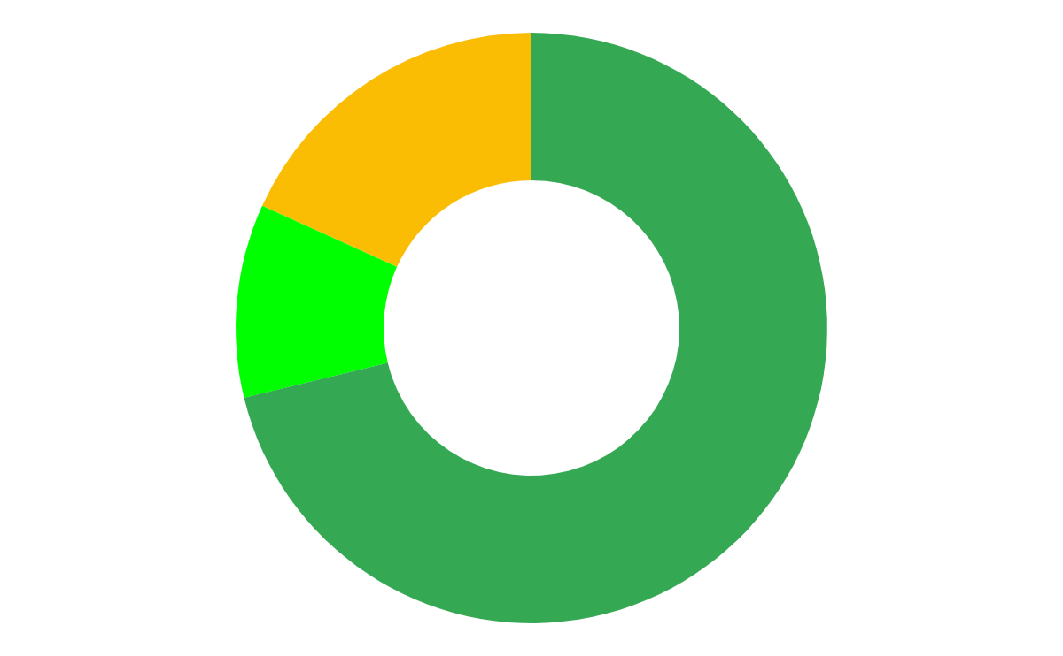
Achievement Related Data: PCS Educator Performance
Highly Effective
Effective
Needs
Improvement
10.2%
71.2%
18.2%
HOME

Slide 11
Data Analysis
According to the data, 18.2% of the teachers are classified as "Needs Improvement," which can negatively impact student achievement and overall school performance. Additionally, this situation may contribute to lower student engagement and satisfaction, as well as higher rates of behavioral issues and absenteeism.
School counselors can address educator performance by implementing professional development programs, establishing mentorship systems, fostering collaborative practices through Professional Learning Communities (PLCs), and providing regular, constructive feedback through classroom observations.
HOME

Slide 12
Standards and Competency Related Data
Only 22% of the students in grades 5-12 took a career interest inventory and 24% in grades K-12 participated in job shadowing or internships suggesting more focus is needed on career exploration.
Did you take a written or online career interest inventory this year? (Grades 5-12)
Yes 22% (320/1482)
No 50% (748/1482)
Not Sure 28% (414/1482)
Did you participate in job shadowing or an internship this year? (Grades K-12)
Yes 24% (465/1952)
No 67% (1308/1952)
Not sure 9% (179/1942)
HOME

Slide 13
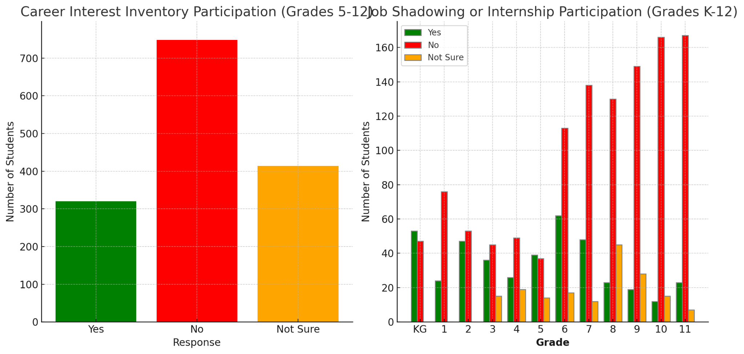
HOME

Slide 14
Data Analysis
School counselors need a career exploration program in their school to ensure that students are adequately prepared for their future academic and career paths. Such programs are essential as they promote career readiness by helping students understand their interests, strengths, and potential career options, enabling informed decision-making. These programs enhance academic engagement and motivation by demonstrating the relevance of education to future opportunities, thereby increasing student drive to succeed. Additionally, career exploration programs can reduce dropout rates by providing students with a sense of purpose and direction, and by offering mentorship and support systems.
HOME

Slide 15
Standards and Competency Related Data
28%
19%
20%
20%
44% of students in grades 3-12 reported stress makes it difficult for them to succeed at school
Fear of making mistakes
People gossiping about me
Feeling sad most of the time
Fear of taking tests
HOME

Slide 16
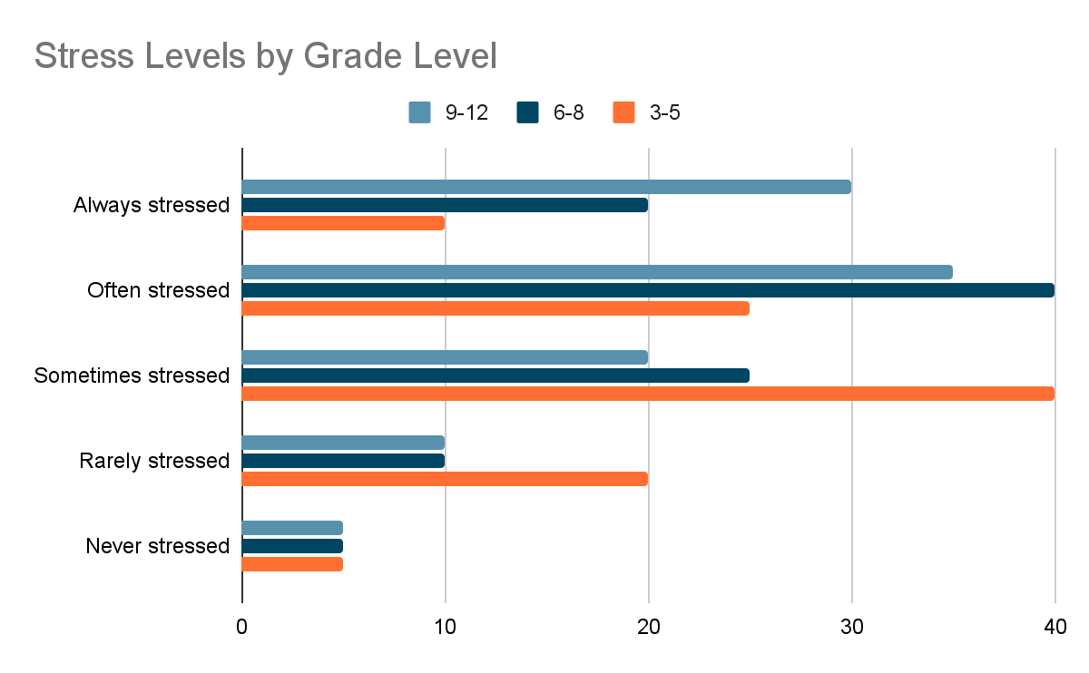
HOME

Slide 17
Stress Impact on Grades by Gender
Male Female
Negatively impacted 35% 45%
No impact 55% 45%
Positively impacted 10% 10%
Stress Impact on Grades by Socioeconomic Status
Low SES High SES
Negatively impacted 50% 30%
No impact 40% 60%
Positively impacted 10% 10%
HOME

Slide 18
Data Analysis
Stress levels tend to increase with grade level, with the highest stress reported among high school students (grades 9-12). Female students report a higher negative impact of stress on their grades compared to male students. Students from lower socioeconomic backgrounds report a higher negative impact of stress on their grades compared to their higher socioeconomic counterparts.
Addressing the problem of stress affecting students in grades 3 through 12 requires a comprehensive approach. A school counselor could organize workshops for students, teachers, and parents to educate them about stress, its effects, and coping mechanisms. He or she could provide lessons that integrate stress management techniques into the curriculum, teaching students about time management, mindfulness, and relaxation techniques. Providing resources and sessions for parents to help them understand and support their children’s stress management would help reduce student stress as well as involving the parents in their child’s education.
HOME

Slide 19
Conclusion
Achievement Data
By using achievement data, achievement-related data, and standards and competency data, school counselors can make informed decisions that support the academic, social, and emotional development of their students, ultimately leading to better educational outcomes.
EOG Scores
EOG Scores
Achievement Related Data
Chronic Absenteeism
Teacher Effectiveness
Standards & Competency Related Data
Career Exploration
Stress Affecting Performance
HOME

